Slide 1
Introduction to Speech Command Identiﬁcation

Slide 2
Recap: What is an Audio Signal?

Slide 3

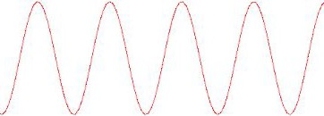

Recap: What is an Audio Signal?
Any vibrating body produces a sound wave

Slide 4
Recap: Audio Representation

Slide 5
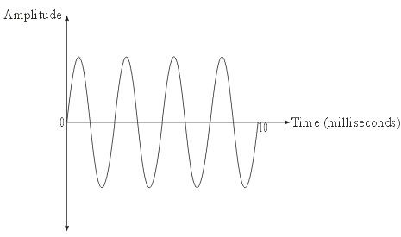
Recap: Audio Representation
Time Domain: Amplitude vs Time

Slide 6
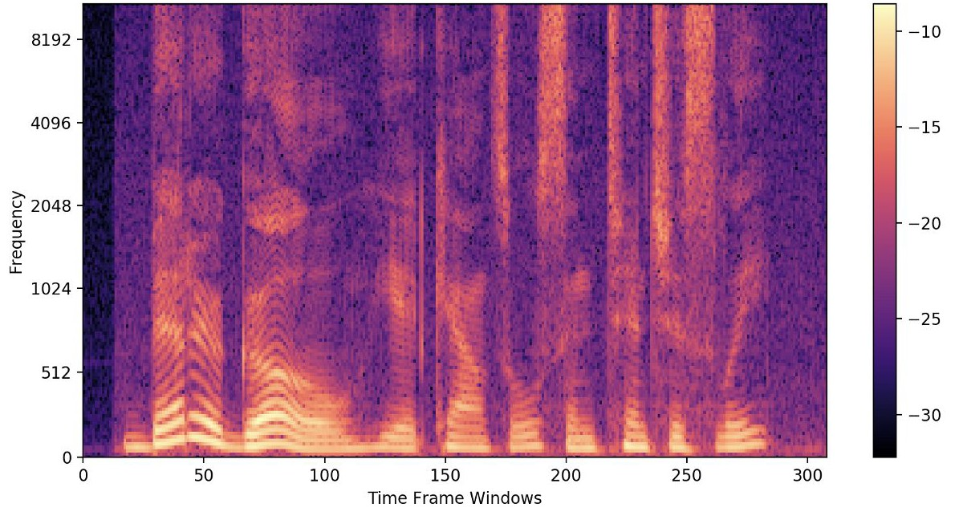
Recap: Audio Representation
Time Domain: Amplitude vs Time
Spectrogram: Every point represents an amplitude of a frequency at particular time

Slide 7
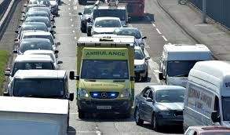

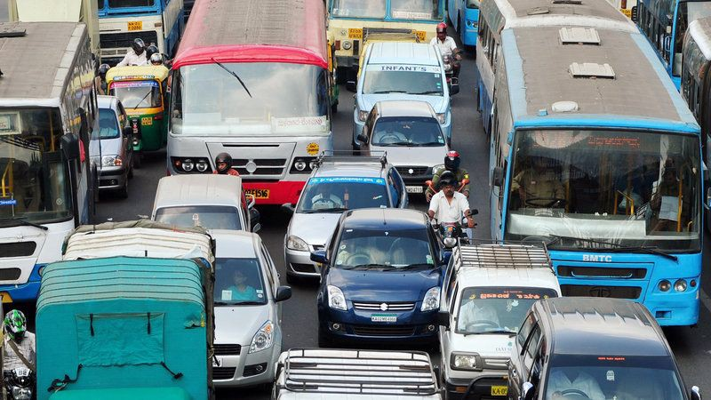
Recap: Data Science Problem - Audio Classiﬁcation
Objective: To build a model that classiﬁes the audio into emergency or non emergency
Emergency Vehicle
Non Emergency Vehicle

Slide 8
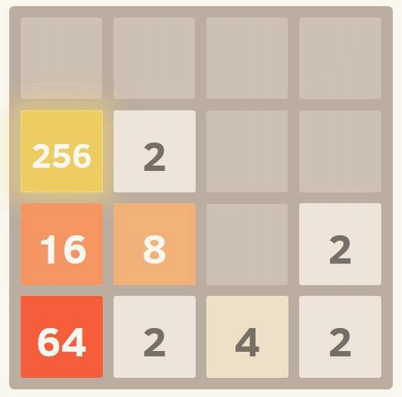
Overview of Problem Statement
Play the game “2048” using speech commands

Slide 9
How to play the game “2048”

Slide 10
How to play the game “2048”
Four ways to move the numbers
Up
Down
Left
Right

Slide 11
How to play the game “2048”
Four ways to move the numbers
Up
Down
Left
Right
If two tiles of the same number touch - they merge

Slide 12
How to play the game “2048”
Four ways to move the numbers
Up
Down
Left
Right
If two tiles of the same number touch - they merge
At each move, one tile randomly occurs in an empty position

Slide 13
How to play the game “2048”
Four ways to move the numbers
Up
Down
Left
Right
If two tiles of the same number touch - they merge
At each move, one tile randomly occurs in an empty position
The game ends when there’s no move available

Slide 14
Overview of Problem Statement
Play the game “2048” using speech commands
Step I - Train a Deep Learning model to identify speech commands

Slide 15
Overview of Problem Statement
Play the game “2048” using speech commands
Step I - Train a Deep Learning model to identify speech commands
Step II - Identify the speech commands in real time to play the game

Slide 16
Overview of Problem Statement
Play the game “2048” using speech commands
Step I - Train a Deep Learning model to identify speech commands

Slide 17
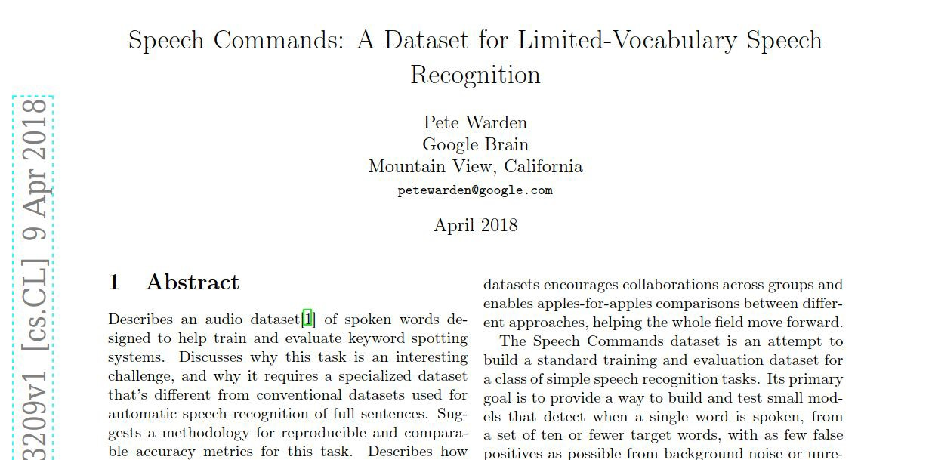
About the Dataset - Speech Commands

Slide 18

About the Dataset - Data Distribution
Speech Command | Audio Sample | Number of audio files
left |  | 3801
right |  | 3778
up |  | 3723
down |  | 3917

Slide 19
Steps to solve Speech Command Identiﬁcation

Slide 20
Steps to solve Speech Command Identiﬁcation
1. Data Loading and Preprocessing

Slide 21
Steps to solve Speech Command Identiﬁcation
Data Loading and Preprocessing
Install important libraries

Slide 22
Steps to solve Speech Command Identiﬁcation
Data Loading and Preprocessing
Install important libraries
Data Exploration

Slide 23
Steps to solve Speech Command Identiﬁcation
Data Loading and Preprocessing
Install important libraries
Data Exploration
Load data using custom Data Loader

Slide 24
Steps to solve Speech Command Identiﬁcation
Data Loading and Preprocessing
Install important libraries
Data Exploration
Load data using custom Data Loader
Speech Command Identiﬁcation using CNN

Slide 25
Steps to solve Speech Command Identiﬁcation
Data Loading and Preprocessing
Install important libraries
Data Exploration
Load data using custom Data Loader
Speech Command Identiﬁcation using CNN
Deﬁne model architecture

Slide 26
Steps to solve Speech Command Identiﬁcation
Data Loading and Preprocessing
Install important libraries
Data Exploration
Load data using custom Data Loader
Speech Command Identiﬁcation using CNN
Deﬁne model architecture
Train the model

Slide 27
Steps to solve Speech Command Identiﬁcation
Data Loading and Preprocessing
Install important libraries
Data Exploration
Load data using custom Data Loader
Speech Command Identiﬁcation using CNN
Deﬁne model architecture
Train the model
Get Inference

Slide 28
Thank You

Slide 29
3. Understanding Real-time Audio Capture

Slide 30
Overview of Problem Statement
Play the game “2048” using speech commands
Step I - Train a Deep Learning model to identify speech commands
Step II - Identify the speech commands in real time to play the game

Slide 31
4. Evaluation of Real-time Speech Commands

Slide 32
5. Play 2048 game using
Real-Time Speech Command Identiﬁcation

